Slide 1


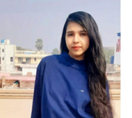


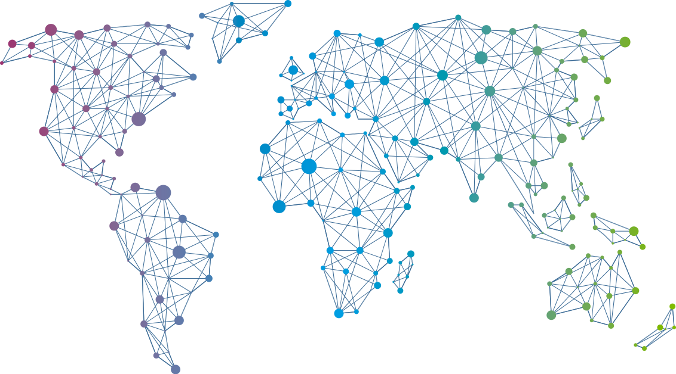

Speaker
Anamika Singh
Diving into Containers
Anamika Singh
reachtoana
September 16th & 17th
^{Online Event}
Powered By
International Conference

